Slide 1


Diabetes Risk Prediction Using Logistic Regression
This presentation explores the development and evaluation of a logistic regression model for predicting diabetes risk using the PIMA Indian Diabetes Dataset. We will delve into the methodology, results, insights, and future directions.
by Uttkarsh Thakur
Khush Prashar, Dheer Pratap Singh

Slide 2
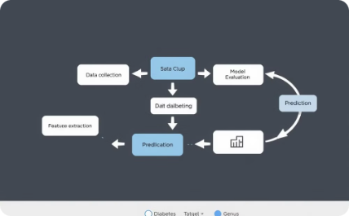
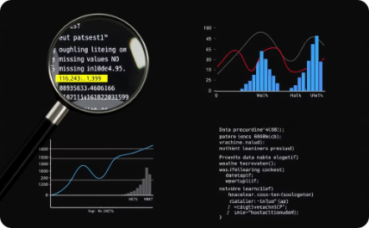
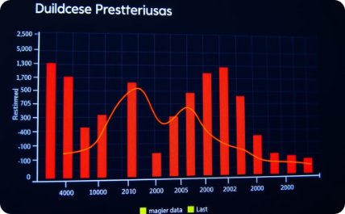
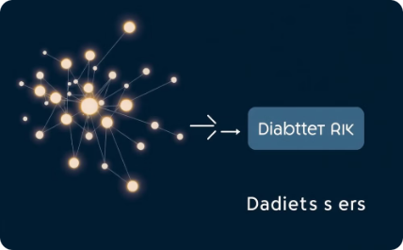
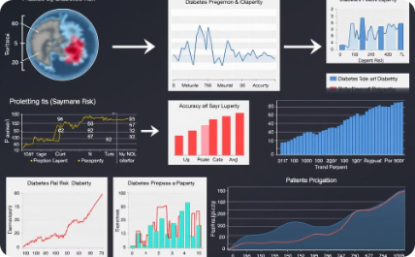

Model Development Flowchart
Data Collection & Preparation
Data Preprocessing & Exploration
Feature Scaling & Selection
Model Training (Logistic Regression)
The journey begins with gathering the PIMA Indian Diabetes Dataset, ensuring its quality and integrity before moving forward.
This involves cleaning the data, handling missing values, and using Exploratory Data Analysis (EDA) to uncover patterns and relationships within the dataset.
Data is standardized through feature scaling. Feature selection pinpoints the most relevant predictors for diabetes, enhancing model efficiency.
Logistic Regression, ideal for binary classification, is employed. Parameters are tuned using methods like cross-validation to optimize accuracy.
Model Evaluation & Validation
Deployment & Future Directions
Rigorous evaluation is performed using metrics like accuracy, precision, recall, and AUC-ROC. Cross-validation ensures model robustness.
The trained model is deployed, possibly as a web application for user risk assessment. Future research will refine the model further.

Slide 3
Methodology: A Detailed Look
Data Analysis
Data Preprocessing
Model Selection & Tuning
Evaluation Metrics
Missing or invalid values in features like glucose and insulin were identified and addressed.
Zero values were replaced with the means of the respective features, and features were standardized for consistency.
The model's performance was evaluated using accuracy, precision, recall, and the F1-score.
Logistic Regression was chosen for its efficiency and interpretability, and Grid Search CV was used for hyperparameter optimization.

Slide 4
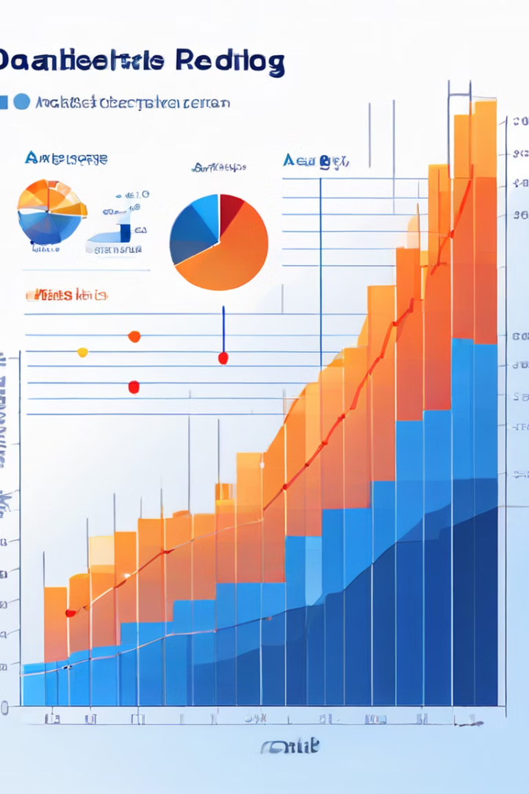
Results and Analysis
Predicted Positive
Predicted Negative
Actual Positive
99 (True Positives)
24 (False Negatives)
Actual Negative
28 (False Positives)
41 (True Negatives)
The model achieved a training accuracy of 77.59% and a testing accuracy of 72.91%, indicating good generalization performance. Further analysis revealed a precision of 80.49%, signifying the model's accuracy in predicting positive cases. The recall score of 77.78% highlights its ability to correctly identify actual positive cases. Finally, the F1-score, balancing precision and recall, was calculated as 79.11%. The confusion matrix, shown above, provides a detailed breakdown of the model's predictions against actual outcomes, illustrating its effectiveness in classifying diabetes risk.

Slide 5

Key Insights and Challenges
Impact of Data Preprocessing
Logistic Regression's Efficacy
Effective data preprocessing significantly influences the model's predictive accuracy. It ensures data quality and consistency, directly impacting performance.
Logistic regression demonstrates its effectiveness and interpretability in diabetes risk prediction. Its suitability for binary classification contributes to its robust performance.
Addressing Data Challenges
Challenges such as zero values and outliers were effectively addressed through median replacement and appropriate outlier handling techniques. These steps ensured data reliability and improved the model's ability to generalize.

Slide 6



Conclusions and Future Works
Robust Model
Practical Solution
Future Enhancements
The model offers a practical and interpretable solution for healthcare, aiding in diabetes risk assessment.
Future work includes exploring advanced algorithms, addressing class imbalance, and developing a user-friendly application.

